Slide 1
Economics of Oil and the Market for Oil and Institutions Relevant to Globalization

Slide 2
Importance of Institutions
To show why institutions play such a prominent role in development performance
To highlight some of what has been learned about their role in development performance – both historically and in the contemporary experience - despite the methodological difficulties concerned
To warn against applying to institutional analysis the same kinds of fundamentalisms that have often plagued various other approaches to the analysis of development performance.

Slide 3
Definition of Institutions
Institutions: rules- formal or informal- which purposely or not can affect behavior of individuals, groups, firms or governments in such a way as to make their behavior more predictable

Slide 4
Functions of institutions
Market Functions:
  market-creating: property rights institutions
  market-stabilizing: controlling inflation, volatility and financial crises via monetary and fiscal management
  market-legitimizing: rules that protect long time users of land from suddenly being evicted by a new outside owner, unions or other labor market institutions that can protect workers from some form of exploitation
  market-regulating: mitigating unwanted externalities and/or allowing economies of scale to be taken advantage of

Slide 5
Functions of institutions
Non-market functions
  Households
    Reduce the transaction costs
    Risk-sharing
    Increase its reputation for reliability in meeting its obligations and responsibilities
  Firms
    Reduce the transaction costs
    Resource pooling bring together employees of many different skills and specialization and capital
  Governance Institutions: Make policies credible and stable
    system of constitutional checks and balances in government

Slide 6
Functions of institutions
  rules of government
    Facilitate the production of public goods by making it easier to collect taxes and to reach collective choices about allocation criteria
    Peace-making or cooperation- inducing
redistribution objective of institutions
  winning benefits for a particular group at the expense of others
  improving private good
  Can facilitate compromises in legislation and enforcement

Slide 7
Incentives in Oil: Some Intuition
Assume that you are an owner of a large oil well but that there is always a back up alternative investment that earns you 3% per annum. Also assume that the costs of extraction of oil are minimal. Oil prices change over time.
What should you do when prices fall?
When they rise?

Slide 8
Computing the Present value of an Oil Well Producing for 10 years
PV = I₀ +q₁ (p₁-c₁) / (1+r) + q₂ (p₂-c₂) /(1+r)²+ ..
This formula illustrates the relevance of numerous factors on the incentives for drilling for oil: Initial drilling cost I₀, production cost c in different periods, expected price in different periods, quantity of output in each period, time preference or alternative real rate of return
For any given field it is quite expensive to try to increase the extraction rate since this may require new drilling, changing pumps, pipes

Slide 9
Hotelling’s Rule in Competitive Case
Rate of return on oil depends on what happens to the net price (p-c) over time
If it is expected to rise at a rate higher than the alternative rate of return, it pays to stay in oil, i.e. keeping the oil in your well
If it is expected to rise less than this, you will want to get out of oil immediately and hence pump it out fast
Hence, in equilibrium, the net price should be expected to rise at the rate r

Slide 10
Limitations on Hotelling’s Rule
Property Rights (nationalizations in MENA 1971-75)
Needs for income (oil revenues)
Legitimacy, Military
Importance of cost considerations
Boycotts by producers and consumers

Slide 11
Ricardian Rent Applied to Agric Land
Land varies in quality, proximity to market etc.
At any point in time there will be equilibrium between supply and demand such that the marginal land will have price = marginal cost and hence earns no rent. Yet, for the higher quality land, p>MC and hence Ricardian rent will be earned by the infra-marginal producers
Application to oil: location, size of pool, and quality of crude (Nigerian sweet), depth of pool,

Slide 12
Some Implications for Today’s World
Historical evolution of the industry
Rivalries among Developed Countries and now China in gaining access to oil
Energy Policy and Environmental considerations
Links to Political Instability

Slide 13
Backstop Technology
Price at which a technology based on a non-depletable resource becomes available
Usually this is very uncertain. This assumed cost seems to rise over time
While for oil, another depletable resource like coal is an alternative to oil, but in reality these two prices tend to move closely together indicating that these are both presently used simultaneously. Hence, it is not really an effective backstop technology
Once the backstop would start to come in, the remaining oil would sell at the cost of the backstop

Slide 14
Monopoly Pricing MR=MC, P>MC
If so, this can be another source of high profits or rent
Higher price, smaller quantity consumed and produced, implying longer time before the resource is fully depleted

Slide 15
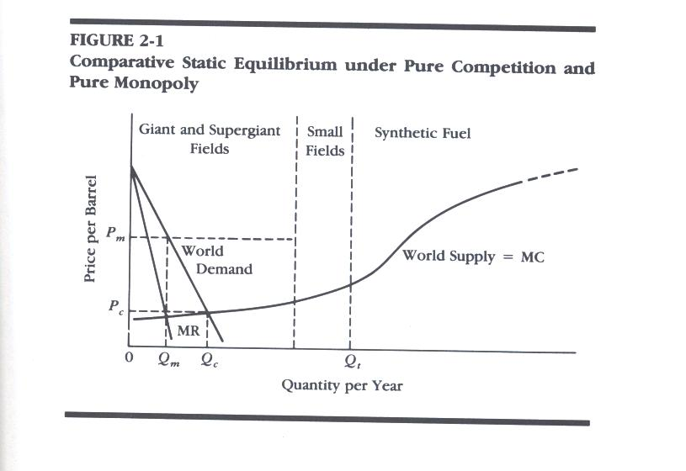

Slide 16
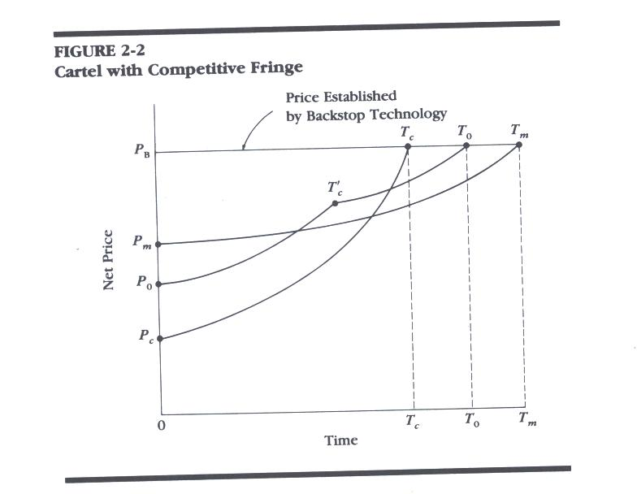
Cartel with Competitive Fringe. Fringe reserves are depleted after T’_{c}

Slide 17
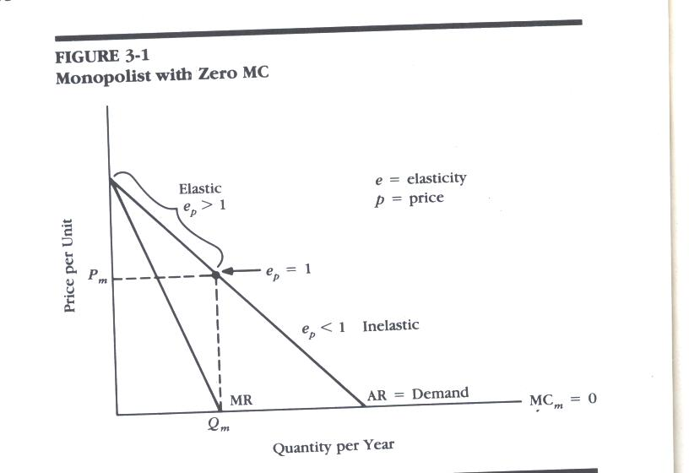

Slide 18
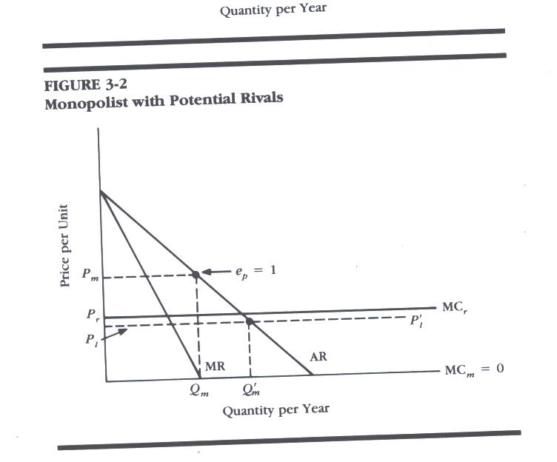
Rivals’ MC
Limit Price < MC_{r}

Slide 19
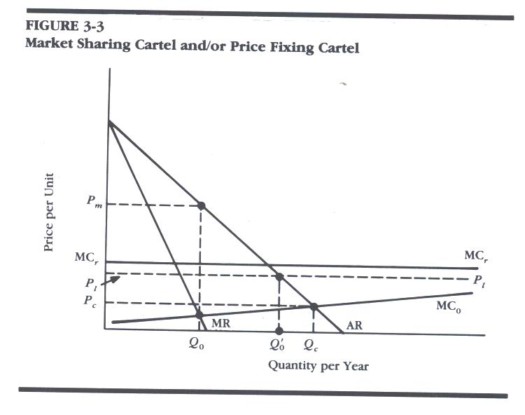
Two problems:
Internal Cartel Problem: With Pl>MCo, members
Have incentive to cheat on quota and sell more,but
This moves the output toward Qc
External Cartel Problem: if P is high rivals enter
Cartel MC

Slide 20
The Oil Producers Organizations
OPEC formed in 1960
  Founders: Venezuela, Iran, Iraq, Kuwait, SA
  Later Qatar, Libya, Indonesia, UAE, Algeria, Nigeria, Ecuador, Gabon but the latter two later withdrew, Ecuador rejoined 2007, Angola, joined 2007; Sudan applied
OAPEC formed in 1968-9 originally as a more conservative group to prevent use of oil as political weapon (SA, Kuwait, Libya) joined by Algeria, Bahrain, Qatar, UAE, Iraq, Syria, Egypt, Tunisia, Oman but the latter two have withdrawn

Slide 21
Did Either Organization Act as a Cartel to Raise Prices
Price rise of 1971-3 often attributed to OPEC, but if anything it should be OAPEC which organized boycott of Israel, US, Netherlands
Information about production, exports and hence ability to monitor was very poor at the time
Divisions within OPEC, SA often served as residual supplier but recently exporting maximum, so no longer can play that role by itself.
Alternative Explanations
  Property rights theory and nationalizations of oil
  More recently production quotas more strictly adhered to but still very imperfectly

Slide 22
Production of Crude Oil (Million b/day)
Country/Region | 1980 | 2002 | 2008
U.S. | 10.8 | 8.7 | 8.4
Mexico | 2.1 | 3.6 | 3.5
Canada | 1.8 | 2.9 | 3.4
S. America | 3.8 | 6.9 | 7.2
Europe | 3.0 | 7.1 | 5.4
Eurasia | 12.0 | 9.4 | 12.6
Asia | 5.1 | 8.3 | 8.4
Middle East | 19.0 | 21.5 | 24.6
Africa | 6.2 | 8.1 | 10.7

Slide 23
Shares of Production and Reserves
OPEC 25-30 of Production, MENA about 30%
But MENA share of Proven Reserves about 62% and with Russia and Eurasia added 70%. Though recently Africa and Canada rising quite sharply.

Slide 24
Crude Oil Production in MENA
Country | 1980 | 2002 | 2008
Algeria | 1.1 | 1.6 | 2.1
Egypt | 0.6 | 0.7 | 0.6
Iran | 1.7 | 3.5 | 4.0
Iraq | 2.5 | 2.0 | 2.0
Kuwait | 1.8 | 2.0 | 2.6
Libya | 1.8 | 1.4 | 1.8
Saudi Arabia | 10.3 | 8.8 | 10.2
Sudan | 0 | 0.2 | 0.5
Tunisia | 0.1 | 0.08 | 0.08
UAE | 1.7 | 2.4 | 2.9

Slide 25
Proven Reserves in billions
Country/Region | 1980 | 2002 | 2008
U.S. | 30.8 | 22.7 | 21.0
Mexico | 31.0 | 26.9 | 11.7
Canada | 6.8 | 4.8 | 178
S. America | 25.0 | 86.0 | 110.2
Europe | 26.0 | 18.7 | 14.3
Eurasia | 67.0 | 57.0 | 98.9
Asia | 40.0 | 44.0 | 34.0
Middle East | 362.0 | 685.6 | 748.3
Africa | 57.0 | 77.0 | 114.8

Slide 26
Largest Reserves (MENA Share 63%)
Country | 1980 | 2002 | 2008
Algeria | 8.4 | 9.2 | 12.2
Egypt | 3 | 3 | 3.7
Iran | 58 | 89 | 138
Iraq | 31 | 112 | 115
Kuwait | 68 | 96 | 104
Libya | 24 | 29 | 42
Saudi Arabia | 166 | 262 | 267
Sudan | .2 | 0.6 | 5.0
Tunisia | 2 | 0.3 | 0.4
UAE | 29 | 98 | 98

Slide 27
Dutch Disease Models
Name comes from effects on manufacturing industries in Netherlands after North Sea Oil Boom
Hollowing out of non-oil exports
  Agriculture in Algeria, Nigeria
  Manufacturing in Netherlands
  Something of an exception is Indonesia
How to explain the Dutch disease effects?

Slide 28
Economy with 3 Sectors
Boom Sector (B)
Lagging Sector (L)
Nontraded Goods Sector (N)
All sectors use K, N
Labor is mobile between sectors but capital is not
Wage rate is the same across sectors
Assume country is “small” so that P_{B} and P_{L} are given. What happens to P_{N} ? N? L?

Slide 29
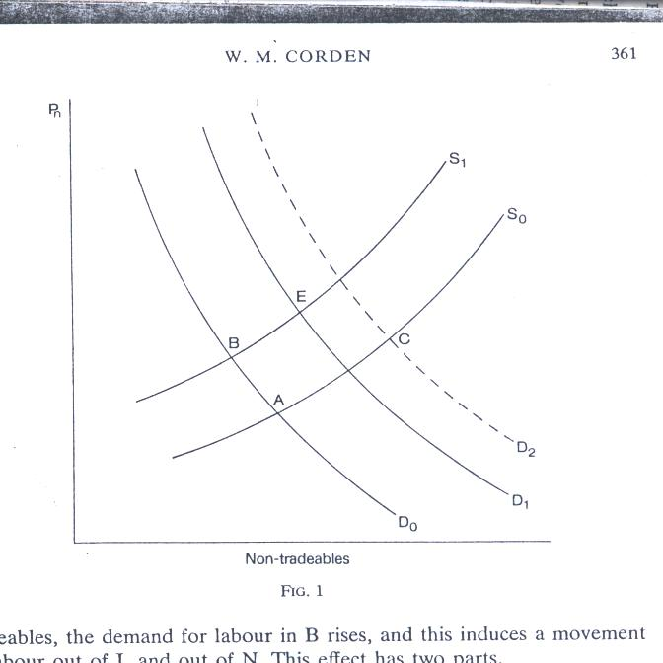
P_{N}
Supply
Effect
F
Demand Effect
N

Slide 30
Spending or Demand Effect has the effect of increasing N and P_{N}
Real exchange rate is P_{N}/ P_{T} = E P/P* where E is $/dinar/ and P is in dinars and P* in $
The boom in B will attract labor from L, N
This causes a Resource Movement Effect or Supply shift in S_{N}
This causes P_{N} to rise even further but the net effect on N is now ambiguous, though most likely N will still increase relative to N_{O}
If B sector is a foreign enclave, there will only be a spending effect, N would rise but L will not decline. If all of this is foreign owned and there are no export taxes or royalties, there might not even be a spending effect.

Slide 31
Labor Supply Effect
Increase in wealth could also impact on households, thereby increasing their wealth and reducing their labor supply.
Whether this would occur would depend on the mechanism. Might be less of it in oil unless people feel richer when investment funds of government increase.
This more likely if the boom comes from remittances from workers abroad directly to households. As a result wage rates would rise

Slide 32
Paradox Model Case
Same assumptions but K is now mobile between L, N sectors but not between B and these sectors.
L,N sectors will necessarily differ in factor proportions. Hence H-O economy such that the movement of labor to B will make labor scarce, increasing the returns to K in the capital intensive sector. If this is L sector, the resource movement effect can be to increase L. (Pro-industrialization result) . In this case the S_{N} would shift further to the left so that P_{N} would rise further, and N could fall.

Slide 33
If N was the capital intensive sector
The resource movement effect would be to the right which could cause PN to fall and increase in N would be very large, L would fall by more.

Slide 34
Immigration Case
If country had small labor force, the effect of the boom would likely be to increase w and thereby encourage immigration. In this case, the lagging sector might not have to fall.
Examples: Bahrain, Kuwait, UAE, Qatar, SA

Slide 35
When P_{N} rises relative to P_{T}
This is exchange rate appreciation making domestic good more expensive in foreign markets, lowering exports and production of L. It may raise the nominal exchange rate ($/Dinar) and/or P/P*
For countries where lots of people are employed in L like Nigeria, Algeria, this effect can be rather devastating

Slide 36



Slide 37
Institutions Relevant to Globalization
Cartels Likely to Form but Not Often Stable. Not just in trade but in Aid: OECD, World Bank, IMF
Organizations once started may outlive their usefulness (IMF until this year). They may take on roles for which they were not designed, e.g., IMF according to recent G20 Summit in London

Slide 38
Regional FTAs more popular than Global Liberalization
Why?
  More likely to benefit because countries are more similar, closer together and therefore may benefit from intra-industry trade
  Easier for politicians to claim credit w/o costs: sign but not enforce, to show they are doing something, easier to limit areas of application
  But also rent seeking behavior more profitable and hence more common. Even bureaucrats may benefit with higher salaried jobs in international agency
  Brazilian example
    As leader of “South” adopts hard-line position in WTO in Doha round and against FTAA. These left largely to bureaucrats
    But very supportive of MERCOSUR with Argentina with heavy involvement of pvt. sector

Slide 39
Quotas vs Tariffs
Generally tariffs less harmful to welfare than quotas
But quotas especially common even though external agencies often pressure countries to convert quotas to tariff equivalents

Slide 40
Why?
Insurance arguments better served with quotas
Rent-seeking
  The quota has to be allocated
  Domestic producers may get the rights to those quotas and thereby obtain monopoly profits

Slide 41
Theory of Customs Union and FTA
Price
Consumer Surplus
SD
DD
PW+T
K
L
PW+T
G
H
I
J
PCU
PCU
A
B
C
D
E
F
PW
PFT
Producers Surplus
DD
QDCU
Q
SDFT
SDT
QDT
QDFT
SDCU

Slide 42
International Product and Other Standards
DC Consumers may get better and safer products
LDC Producers often object viewing these as another form of protection that gets around WTO rules
But these can lead to benefits for those entrepreneurs in LDCs able to take advantage of these: Chilean example

Slide 43
ILO Labor Standards
Human rights
Limiting Gender Discrimination
Worker safety
Rights to organize
Minimum Wages
Child labor
More extensive regulations on working hours, vacation, maternity leave, separation payments. Limits to such regulation

Slide 44
Institutions for Deeper Integration
Common Markets
Common Currency Unions
International dispute resolution
Bilateral investment treaties
Double Taxation Treaties

Slide 45
Trade Sanctions
Multilateral Sanctions Like cartels
Prisoners’ Dilemma: Incentive to defect Problems of sustainability of the cartel and some wanting to stay out altogether. benefits of

Slide 46
Institutions in International Migration
Where are they?
There are needs for coordinating the flows but this doesn’t happen
Some exceptions in certain areas where international markets work well: Philippines

